Slide 1
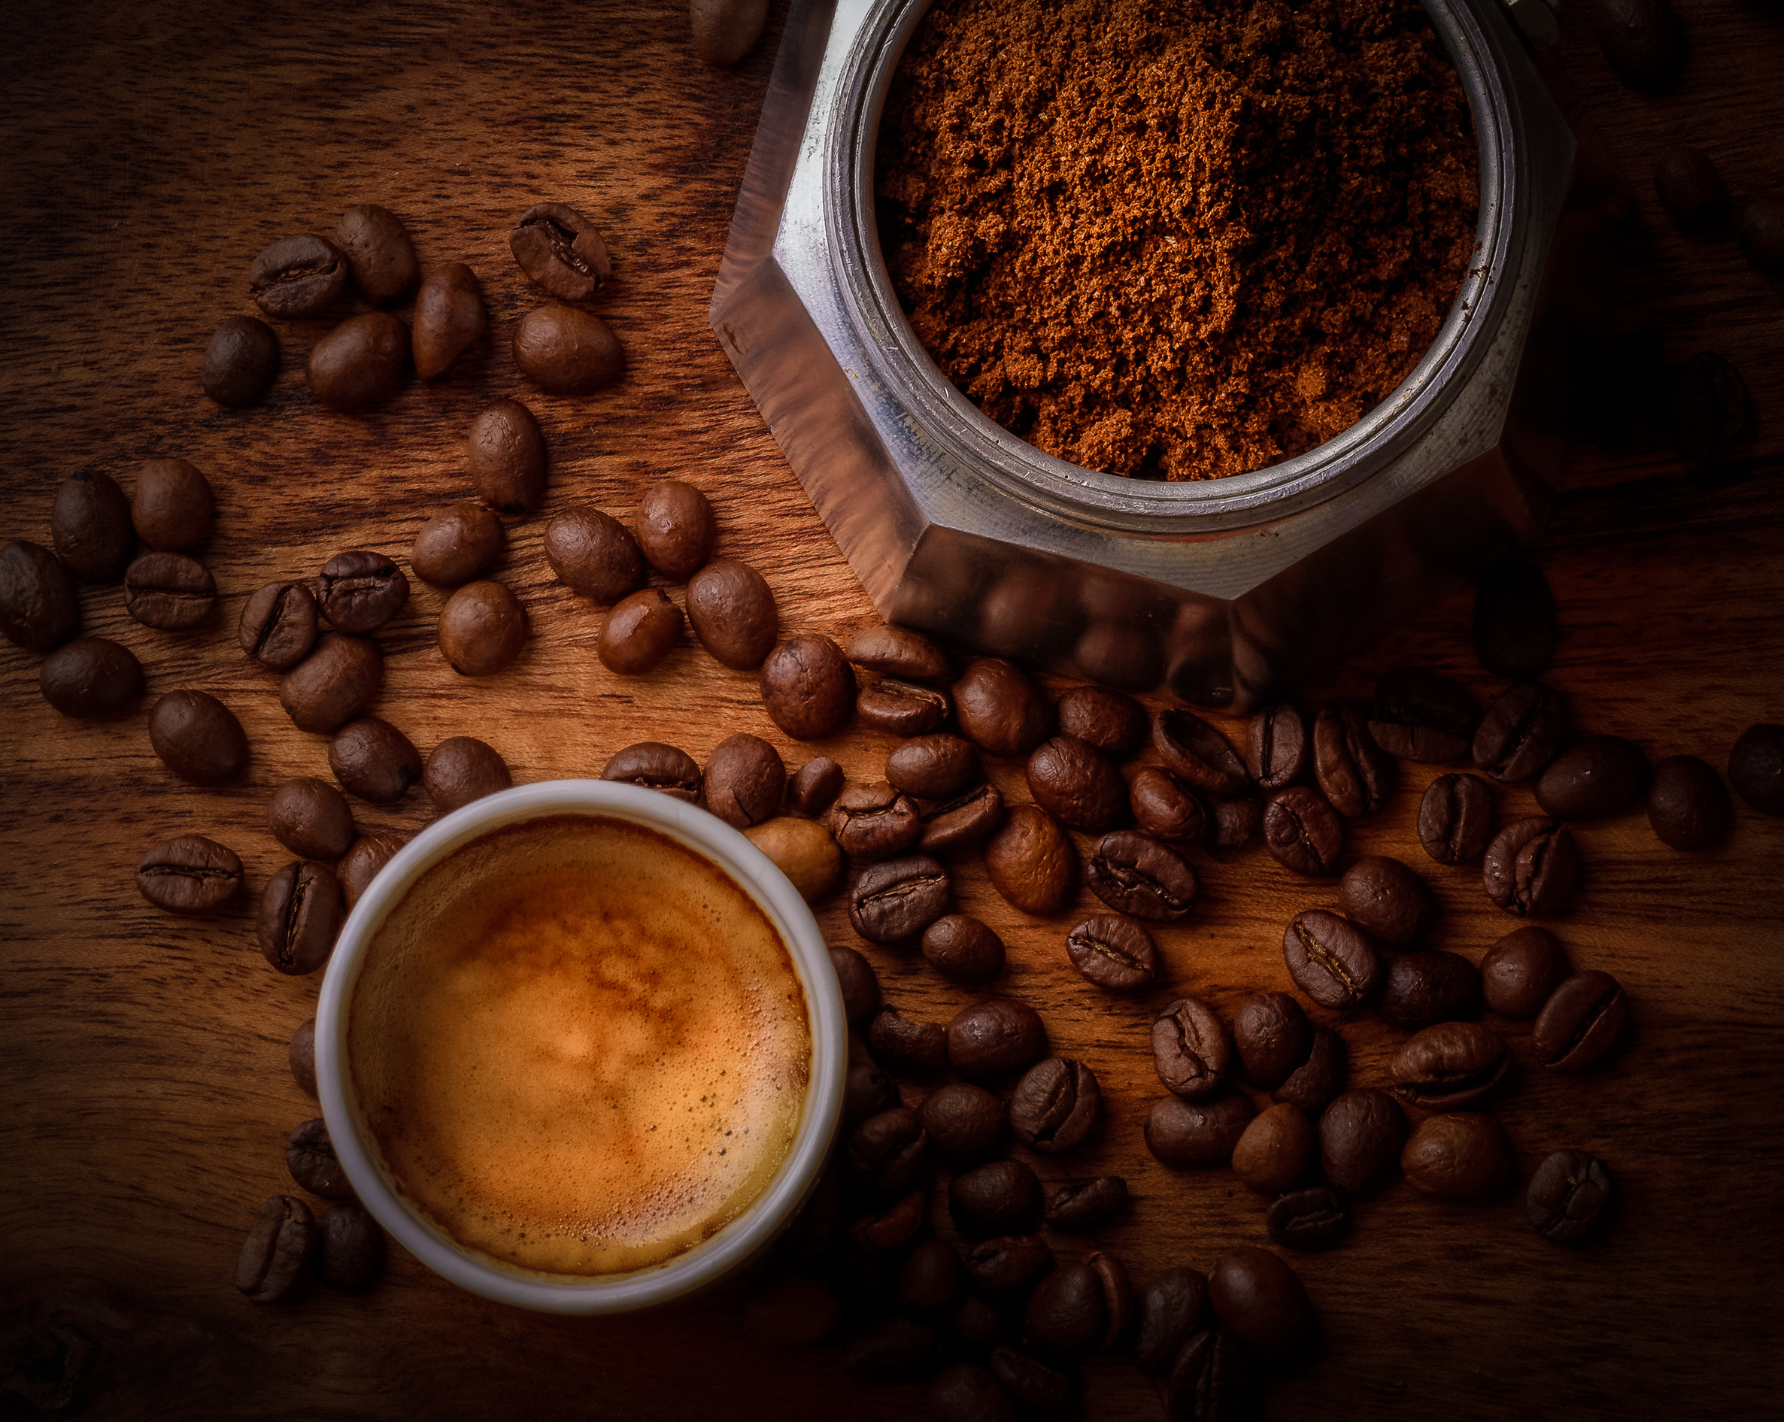

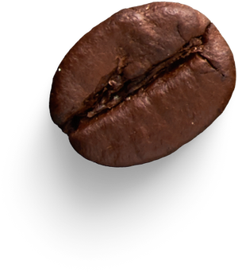
Presented by Nkululeko Choma
Presentation for CEO to provide insights and recommendation related to sales perfomance
Bright Coffee
Shop Presenation
THE BRIGHT WARMTH OF THE WORLD
Contact us
011 475 6648
www.brightcoffee.co.za

Slide 2

Bright Group
Home
Service
About Us
Contact
  Introduction
  Data Systems
  Analysis & Visualization
  Recommendation
  Implementation
  Q&A
Table of Content

Slide 3
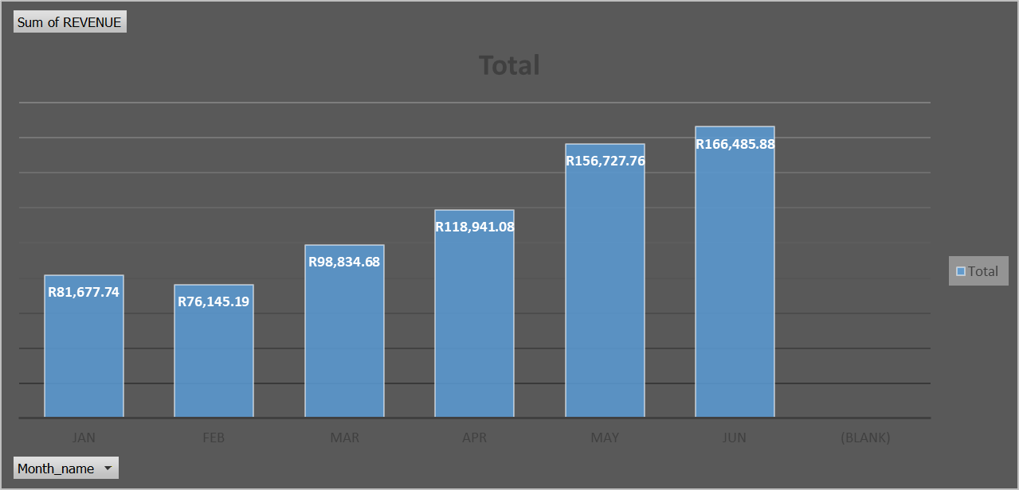
  TOTAL REVENUE ACROSS 6 MONTHS
Bright Group
R698 812.33
  Sales increased by approximately 50% from Jan-June 2023

Slide 4
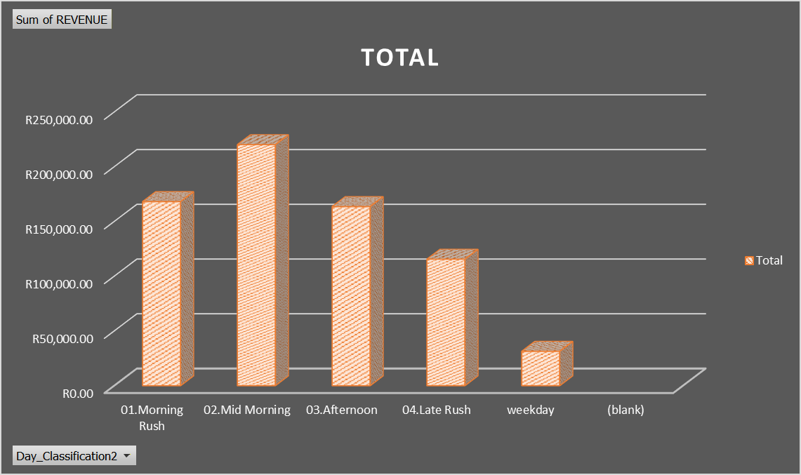
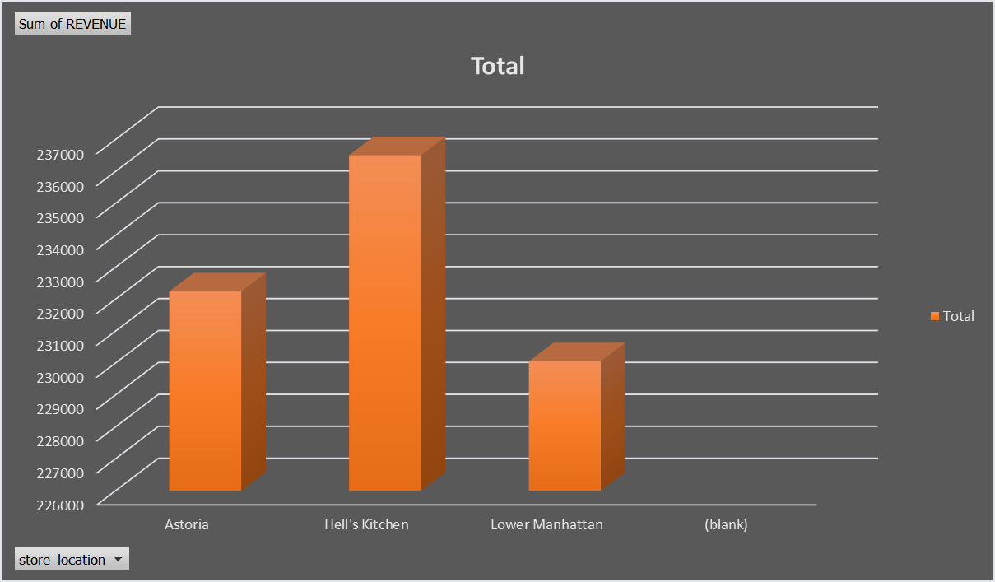
Sales by time of day and store location
Bright Group
  Mid morning is our highest performing time of day more than 50% of sales while weekdays are slowest time
  We have also gathered that Hell’s Kitchen is our highest performing store during this period with 33.8%

Slide 5
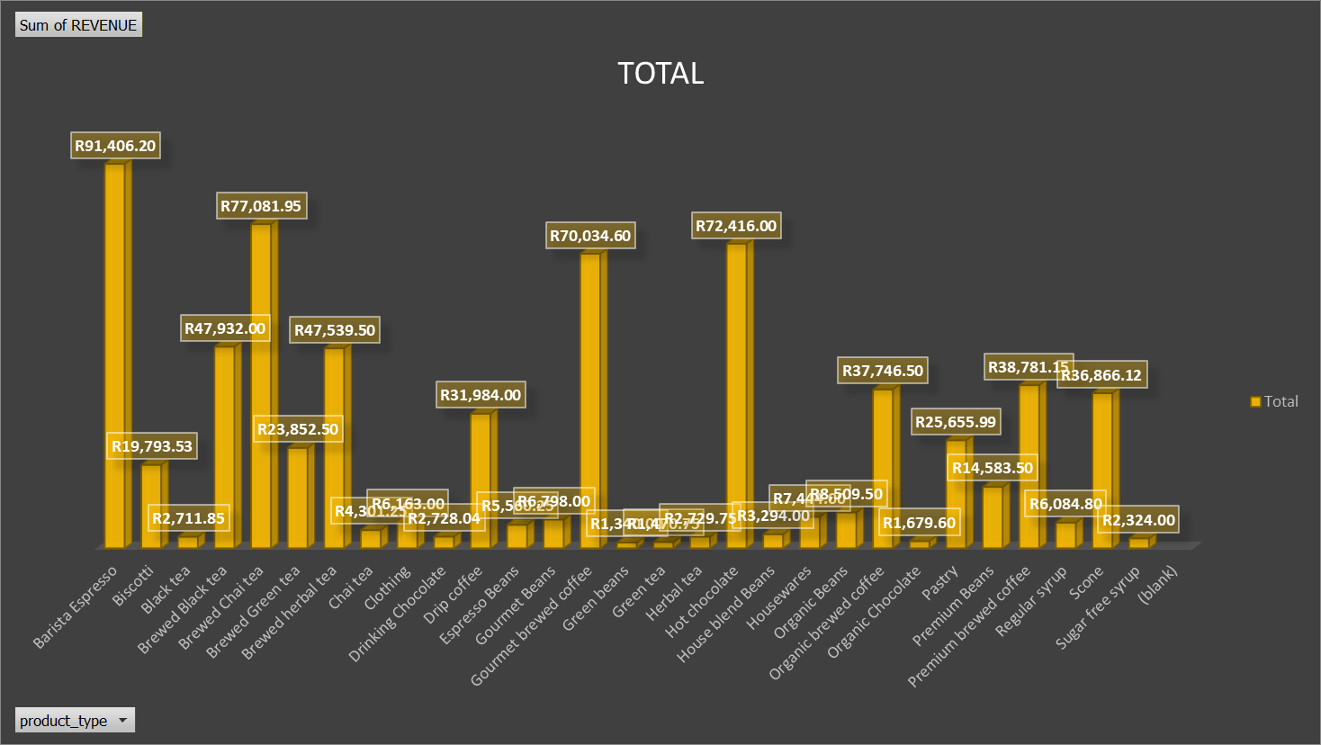
Bright Group
Sales by product type
  The below graph provides insight on our top 4 highest selling product type namely
  Barista Expresso R91406.20
  Brewed Chai Tea R77 081.95
  Gourmet Brewed Coffee R 70 034.60
  Hot Chocolate R72 416

Slide 6
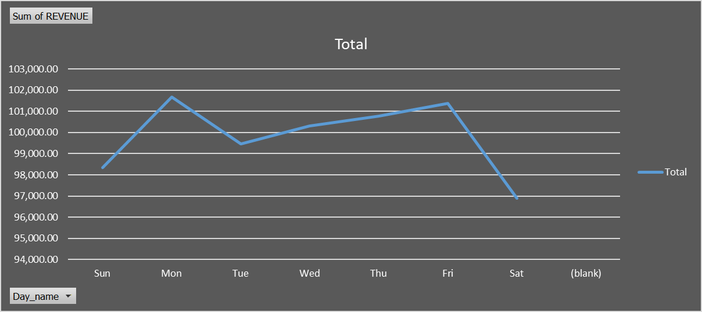
Bright Group
Sales by Day Name
  Based on the below graph over 6 months the best performing day of the week is Mondays with 14.5% of sales
  Saturday have been the lowest performing day of the week over 6 months with 13% of sales
  The Average total sales over 6 months is R116 468.72

Slide 7
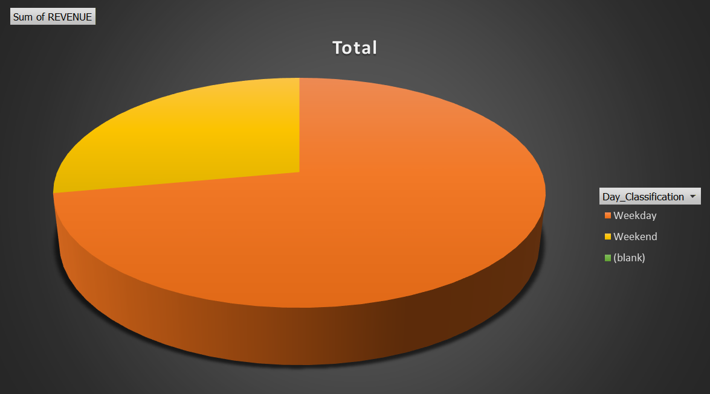
Weekend Sales Versus Weekday Sales
Bright Group
  Based on the below chart we are able to gain information that most of the sales took place Weekdays than Weekend
  Approximately 72.6% of sales take place on Weekdays this makes since due to the number of days in the week and Monday being our best performing days.
  Only 27.4% being on Weekends partly due to the ration of less days interval.

Slide 8

Recommendations
Bright Group
  To improve overall sales for the business and
improve the ‘Bottom-line’ We recommend increased social media present.
  The introduction of Target Marketing through various online platforms to enhance digital footprint and attract new markets.
  Attract health conscious clients by promotional discount of low-perfoming products such as ; Chai tea , Blacl tea and Green tea to boost sales.
  Increasing staff during Mid Morning rush in order maintain excellence customer service during peak time of business and save for when less staff is required.
  Focus more on promoting sales in Lower Manhattan through in store specials on products such as scone, tea and sugar free syrup, to attract more clients in store

Slide 9

Bright Group
Implementation
  Conduct a continuous visualization of data on Power BI in order to give real time feedback on sales and other related statistics to monitor progress.
  Perform a “Deep Dive” data analytics on information to gain even more insights and improve revenue.
  Collaborate with other stakeholder in the industry and value chain to gain more insights on clients behavior and implement best practice to improve revenue.
  Implement staff training especially in locations not performing, to improve customer experience and also encourage clients who visit stores to rate service through a digital dashboard.
  Perform an analysis on the cost and benefit of introducing a Delivery Service platform in order to attract new clients who otherwise don't prefer visiting our stores.

Slide 10
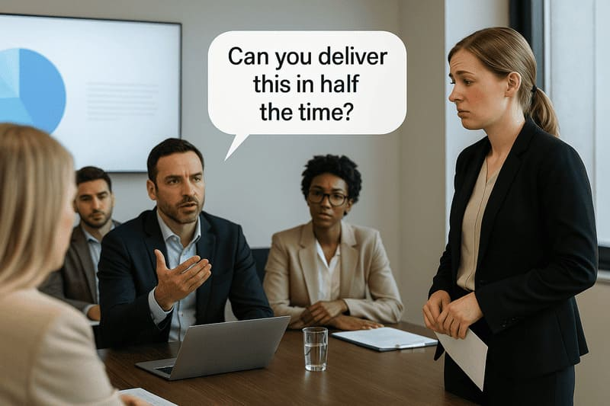
Q&A
Bright group
Thank You

